Slide 1

Containerization for R&D Applications (Part 2): Singularity/Apptainer
Andrew Monaghan
Andrew.Monaghan@colorado.edu
Slides and exercises available for download at:
https://github.com/ResearchComputing/apptainer_spring_2023
Please fill out the course evaluation survey:
http://tinyurl.com/curc-survey18

Slide 2
Outline
Singularity commands and options
Hands-on: Running containers
Building containers
Special cases: Running containers for MPI and GPU jobs

Slide 3
What is a container?
A container is a portable environment that packages some or all the following: an operating system, software, libraries, compilers, data and workflows. Containers enable:
Mobility of Compute
Reproducibility (software and data)
User Freedom

Slide 4


Containerization software
Docker
Well established – largest user base
Has Docker Hub for container sharing
Problematic with HPC
Singularity/Apptainer*
Part 2 - focus of this tutorial
Designed for HPC
**Note: Sylabs spun off the open-source version of Singularity to the Linux Foundation in November 2021. This open-source version has been renamed “Apptainer” to distinguish it from the commercial product, “Singularity” that will still be marketed by Sylabs.

Slide 5
Why Singularity?
Singularity is a comparably safe container solution for HPC
User is same inside/outside container
User cannot escalate permissions without administrative privilege
Can support MPI and GPU resources on HPC (scaling)
Can use HPC filesystems
Supports the use of Docker containers
Container is seen as a file, and can be operated on as a file

Slide 6
Singularity Overview
Singularity Workflow
Key Commands
Running Containers
Seacontainersales.com

Slide 7
The Singularity Workflow
Need Container?
no
Build software in situ on host system
yes
Does Container Exist?
yes
Run container
no
Build Container
We’ll cover this last
We’ll cover this first

Slide 8
Where do I find existing containers?
Docker Hub: https://hub.docker.com
Sylabs Library: https://cloud.sylabs.io/library
Tutorial on finding a running an existing Docker container: https://www.chpc.utah.edu/documentation/software/singularity.php#exd

Slide 9
Key Singularity Commands
build: Build a container on your user endpoint or build environment
exec: Execute a command to your container
inspect: See labels, run and test scripts, and environment variables
pull: pull an image from Docker or Singularity Hub
run: Run your image as an executable
shell: Shell into your image
More: https://www.sylabs.io/guides/3.2/user-guide/cli.html

Slide 10
Running containers
Now, on any system with Singularity, even without administrative privilege, you can retrieve and use containers:
Download a container from Singularity Hub or Docker Hub
singularity pull shub://some_repo/some_image
singularity pull library://some_repo/some_image
singularity pull docker://some_repo/some_image
Run a container
singularity run mycont.sif
Execute a specific program within a container
singularity exec mycont.sif python myscript.py
“Shell” into a container to use or look around
singularity shell mycont.sif
Inspect an image
singularity inspect --runscript mycont.sif

Slide 11
Running Containers
Navigate to the tutorial:
bit.ly/apt_sp23
Seacontainersales.com
The tutorial can also be found here:
https://github.com/ResearchComputing/apptainer_spring_2023

Slide 12
Break!
Please fill out the course evaluation survey:
http://tinyurl.com/curc-survey18

Slide 13
Building containers
Seacontainersales.com

Slide 14
There are 3 ways to build a Singularity container
Build a container on a system on which you have administrative privilege (e.g., your laptop).
Pros: You can interactively develop the container.
Cons: Requires many GB of disk space, requires administrative privilege, must keep software up-to-date, container transfer speeds can be slow depending on personal network connection.
Build a container on Sylabs remote builder (this may change w/ “Apptainer”!)
Pros: Essentially zero disk space required on your system, doesn’t require administrative privilege, no software upgrades needed, easy to retrieve from anywhere, final container is placed on local machine
Cons: Cannot interactively develop the container, ‘Freemium’ version limited
Build a docker container and “pull” it as a singularity container

Slide 15
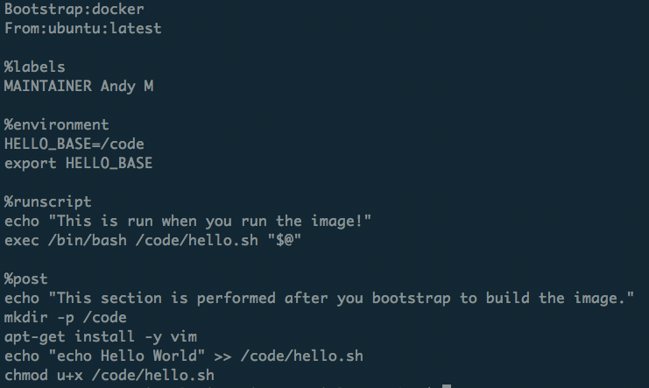
What is a recipe?
Header
Metadata
Runtime environment variables
Default program at runtime
Where software and directories are installed at buildtime
More: https://www.sylabs.io/guides/3.2/user-guide/definition_files.html

Slide 16
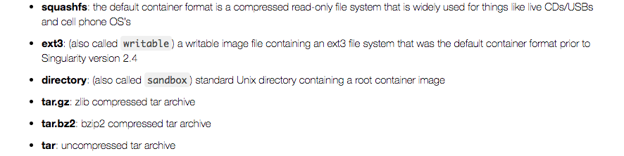
Container Formats
*.sif format and older *.simg format
(immutable final container format)
Writeable sandbox used for interactive container development
https://singularity.lbl.gov

Slide 17
1. Building a container interactively (demo)
Bootstrap a base container (has OS you want, maybe other stuff too) into a sandbox:
sudo singularity build --sandbox mytest/ docker://alpine:latest
Shell into the container and install what you need by trial and error:
sudo singularity shell –-writable mytest/
[now do stuff in container; as you get it correct, add commands to Singularity recipe]
Now finalize container.
You can either build squashfs image from sandbox:
sudo singularity build mytest.sif mytest/
Or you can build squashfs image from recipe (best practice):
sudo singularity build mytest.sif Singularity

Slide 18
2. Building a container with Sylabs Remote Builder (demo)
Get a token from Sylabs Cloud: https://cloud.sylabs.io/auth
Login using your Github account
Create a new token under “Keystore”
Copy the token string (<your-token>)
Add the token on your host machine:
singularity remote login
Then paste your token when prompted.
Issue the command to build your container remotely
singularity build --remote myimage.sif Singularity
…where “Singularity” is your definition file. If successful, the container will be placed in your working directory

Slide 19
Thank you!
Please fill out the survey:
http://tinyurl.com/curc-survey18
Contact information:
Andrew.Monaghan@Colorado.edu
Additional learning resources:
Slides and Examples from this course:
https://github.com/ResearchComputing/apptainer_spring_2023
Web resources:
https://apptainer.org/docs/user/latest/(user guide for Apptainer)

